Slide 1
HOTEL AUTOMATION SYSTEM
Group 15
Hotel Milestone

Slide 2
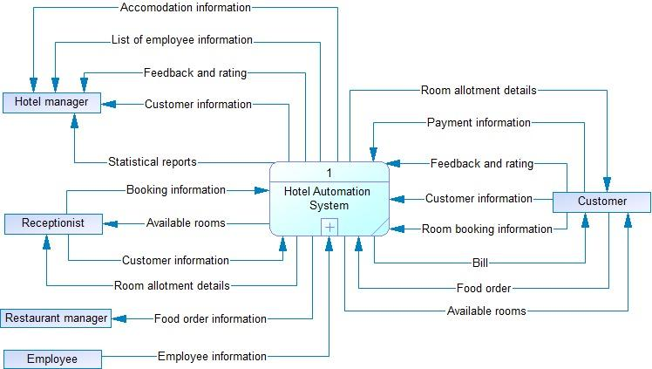
Context Diagram

Slide 3
User Stories
Epic 1.1 : Reservation
User Story 1.1.1 : Finding room :-As a customer I want to search for room using different filters such as type of room, price range, etc.
User Story 1.1.2 : Book room :- As a customer I want the app to take the room number and book that room for certain days.
Epic 1.2 : Managing Room Database
User Story 1.2.1 : Search/update :- Using this feature, The users can query for search in the room database and get the details of room like single or double bed room, AC or Non-AC room etc. The Receptionist can update the room status as vacant or non vacant.
User Story 1.2.2 : Update room type :- As a manager, this feature gives me the access to room details so i can change the room details like convert Non-AC room to AC room.

Slide 4
User Stories
Epic 1.3 : Billing functionality
User Story 1.3.1 :- When a payment is received for a food order or a room reservation, an entry is made into an account Database, the system should generate a bill that reflects the transaction.
Epic 1.4 : Payment
User Story 1.4.1 :- Customer or user should have choice to pay online or offline also they are permitted to use credit/debit card.
User Story 1.4.2 :-If an online payment fails, the system must provide a notice stating that the payment was unsuccessful and that the user should try again later..

Slide 5
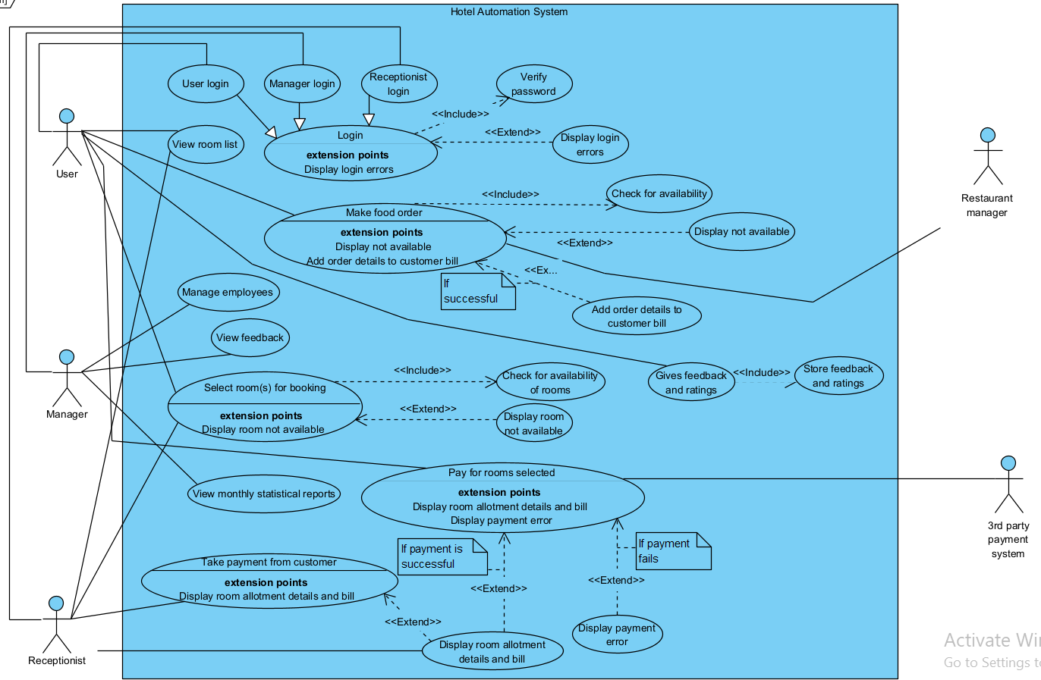
Use Case Model

Slide 6
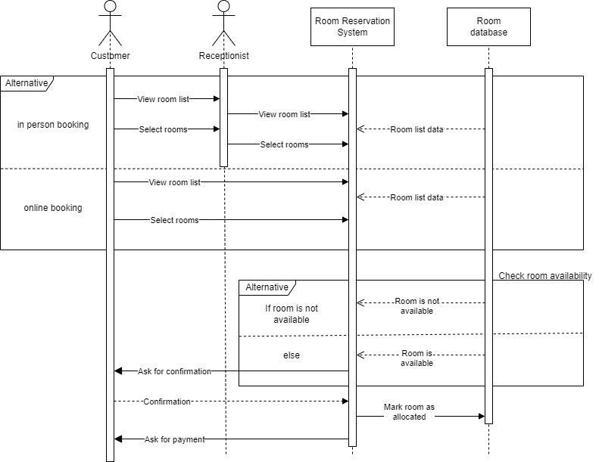
Top Level Sequence Diagram-Room Reservation

Slide 7
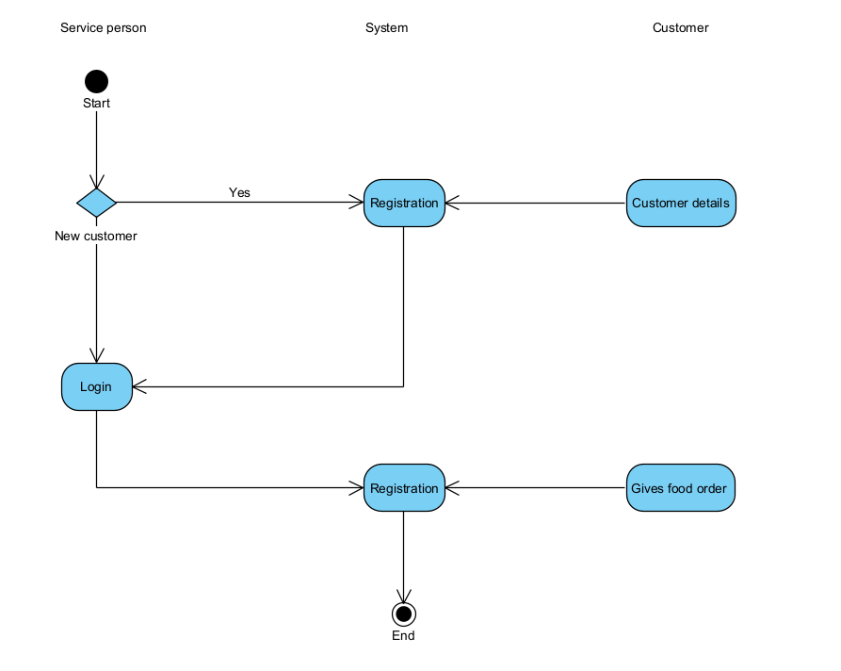
Activity Diagram-Food Ordering
No
For Food

Slide 8
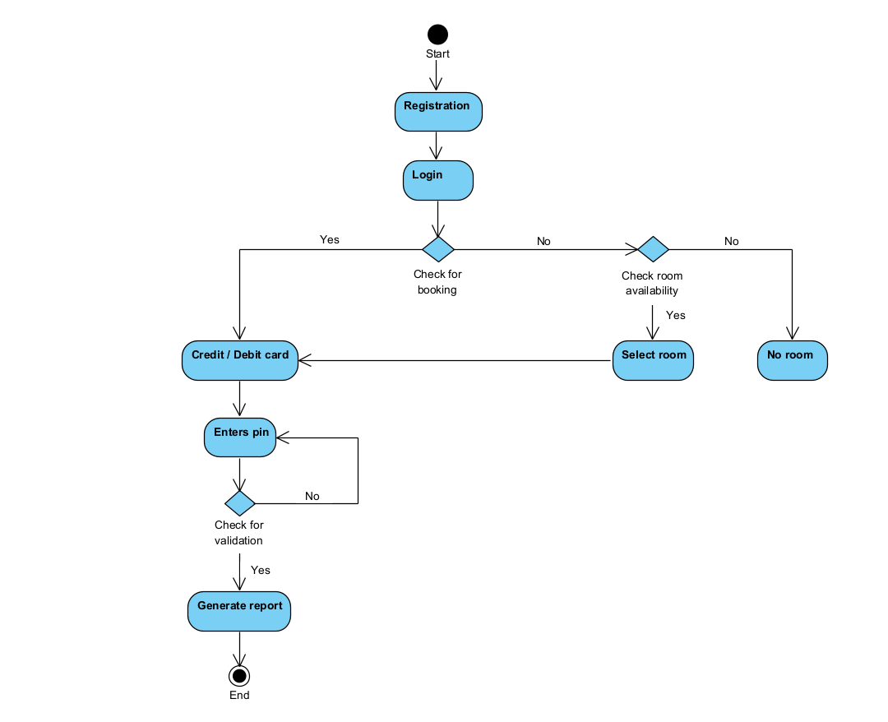
Activity Diagram-Payment

Slide 9
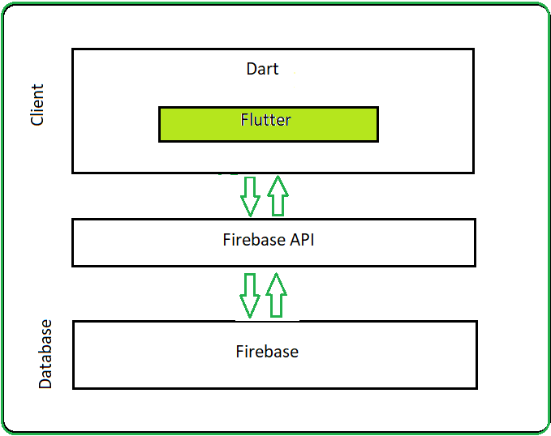
Application Architecture
Flutter is designed as an extensible, layered system. It exists as a series of independent libraries that each depend on the underlying layer.
No layer has privileged access to the layer below, and every part of the framework level is designed to be optional and replaceable.
Typically, we interact with Flutter through the Flutter framework, which provides a modern, reactive framework written in the Dart language.

Slide 10
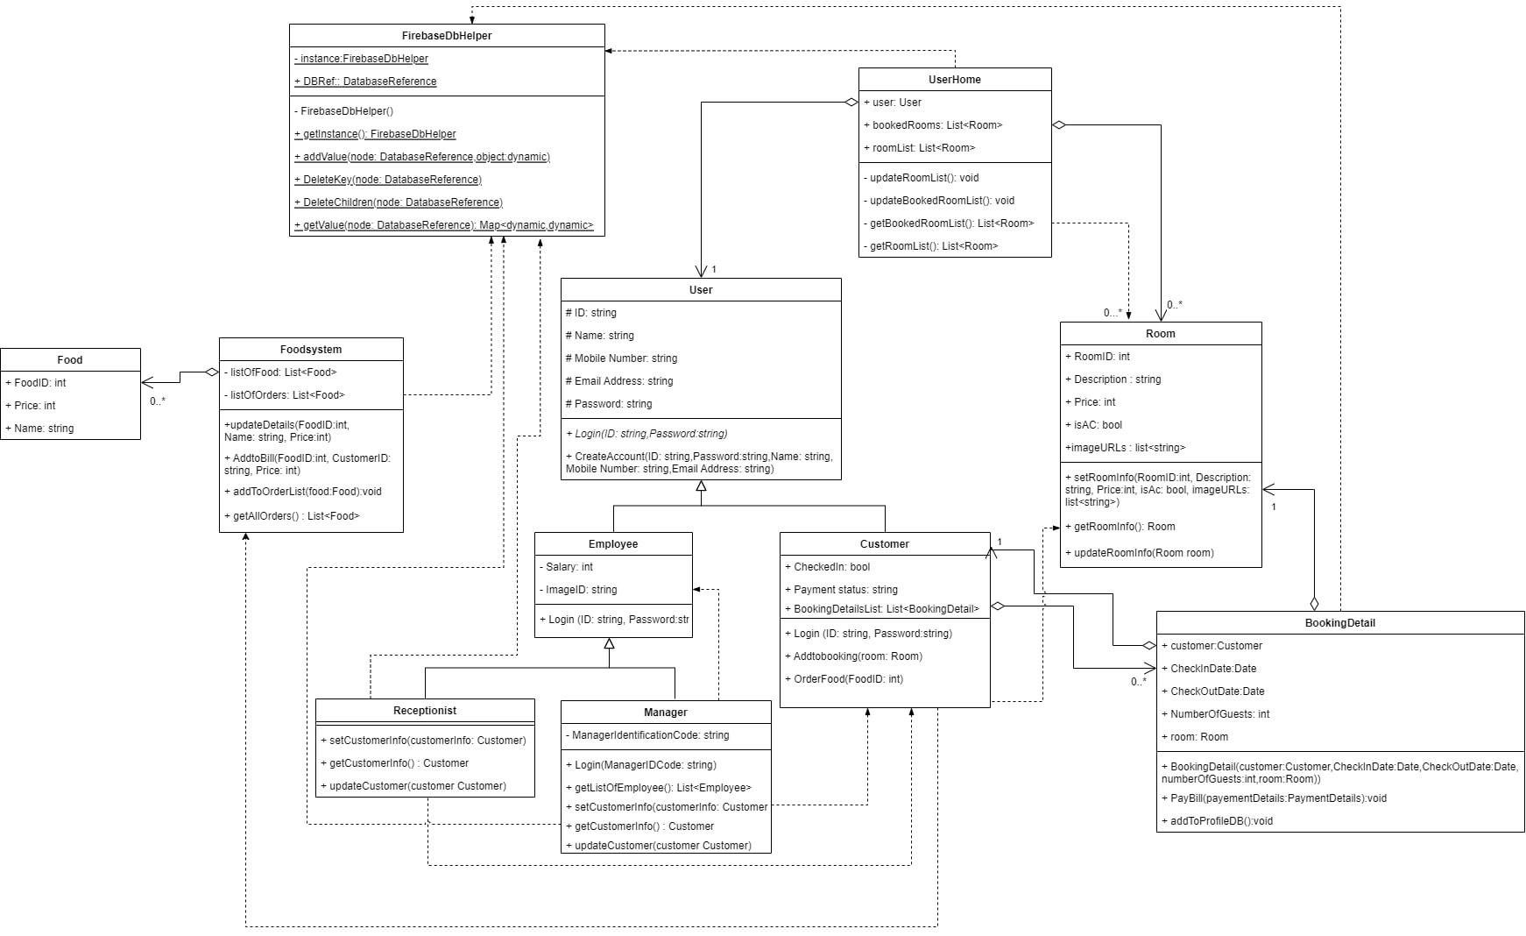
Class Diagram

Slide 11
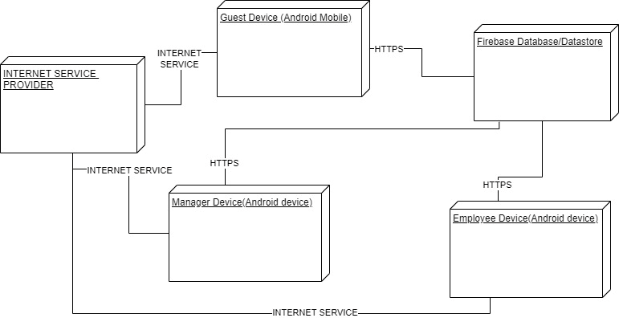
Deployment Diagram

Slide 12
Technologies/Tool and Libraries
Technologies : Flutter ,Dart ,Android SDK ,Firebase Database and Cloud Firestore
Tools : Visual Studio Code , Android Emulator
Flutter Libraries : firebase_core: 1.14.0
firebase_database: 9.0.10
file_picker: 4.5.1
firebase_storage: 10.2.12
path: 1.8.0
cupertino_icons: 1.0.2
cupertino_date_picker

Slide 13
Summary of Implementation
The App is Developed using Flutter which uses Dart as Programming Language.
The Login System is the first component that we implemented. In Login system we have 3 modes to login for 3 user roles which are User,Employee,Manager.
User Login:
In the User Login page we display 2 input text fields which are username and password and one Login Button. When the user clicks on Login button the application grabs the username and password and checks the database for the existence of account and if the account exists the user is logged in.
Manager Login:
In the manager login page we display 1 input field for manager identification code and a button for login. When manager clicks on the login button we check for the entered code against the code already defined when developing. If the login is successful then we display the manager home page which contains the managerial actions such as create room.

Slide 14
Summary of Implementation
For database we used Firebase realtime database which provides NoSQL cloud database to store and sync data.We use the Firestore to store the room images on cloud.
Room booking system:
The Manager has ability to create room entry which can be opened by the button on the manager home page. On the create room page we ask for the necessary room details along with the pictures of the room if needed. We upload the pictures to firestore and index them using the room id entered and also store it inside the room database. In the Customer home page we display the available room options list which is dynamically generated using the realtime data from the room database which stored on the firestore.
When the user opens any particular room the user is shown a screen in which all the details of the room is displayed. If the user want to book the room then user can press on the Add to booking floating button.after that the user is redirected to the room booking page where we take check in and check out date, number of guests as input and then after pressing the book room button we upload the booking data to Database and we store it in user section. After booking the room user’s profile screen will show all the room he/she has booked.

Slide 15
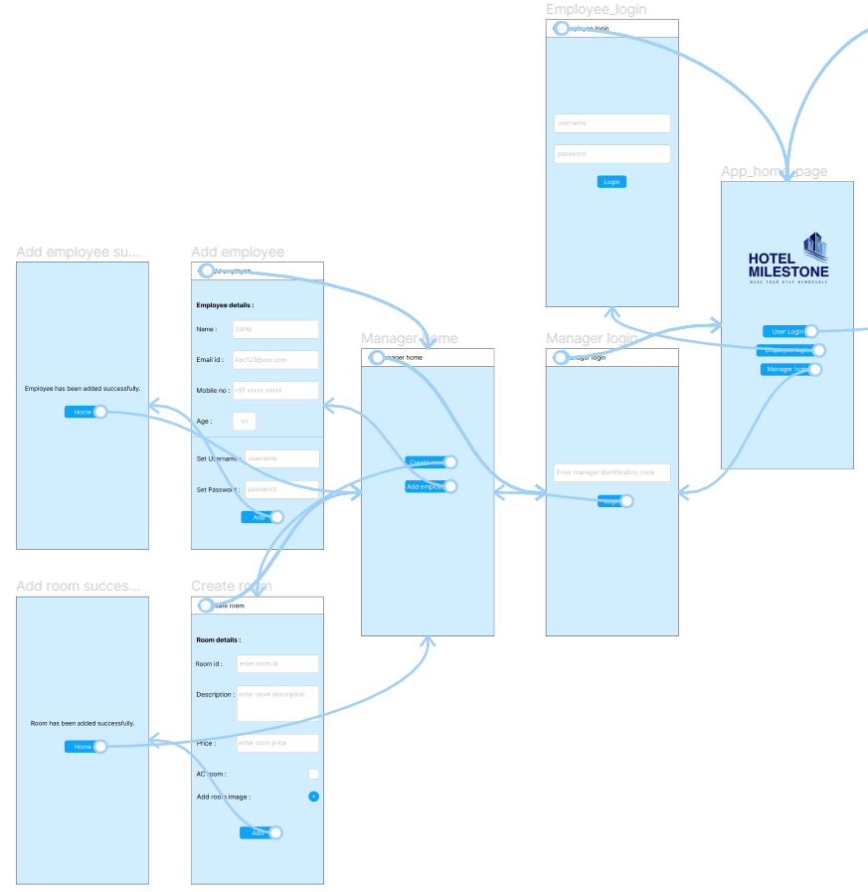
Application navigation using UI / UX design

Slide 16
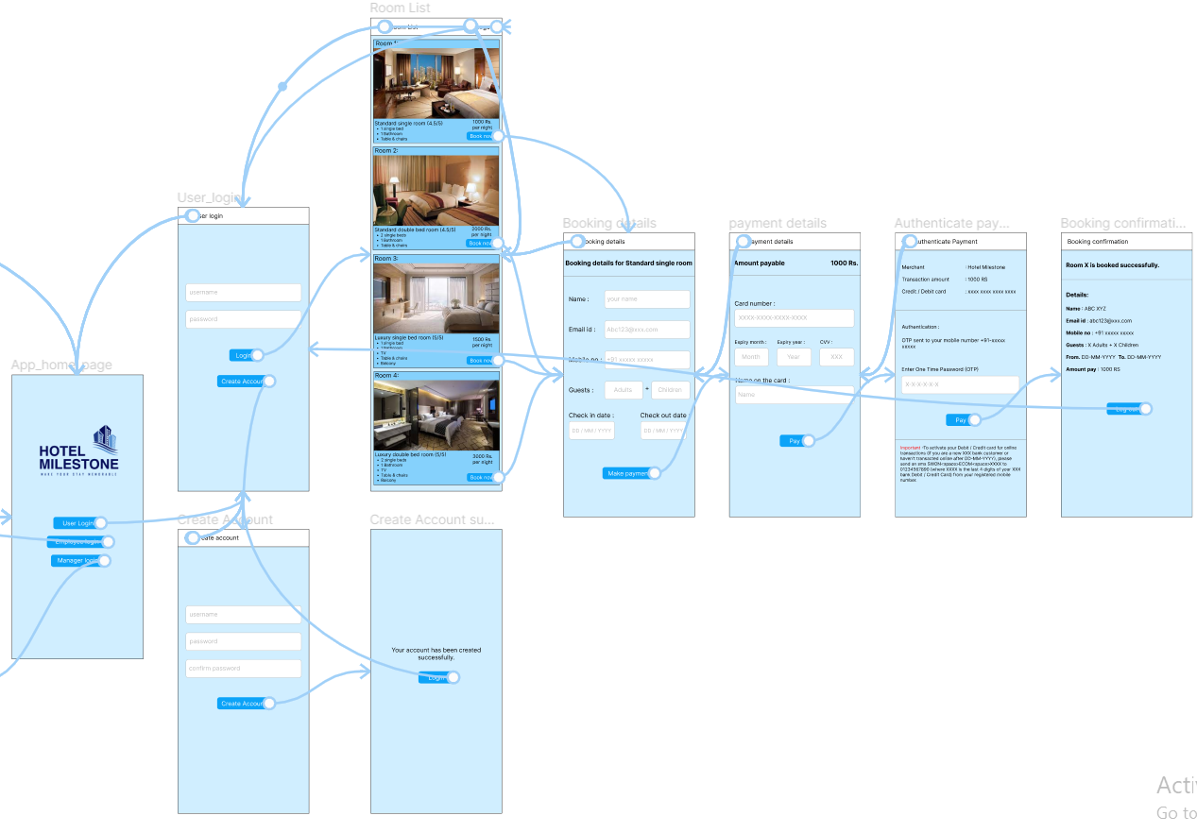
Application navigation using UI / UX design

Slide 17
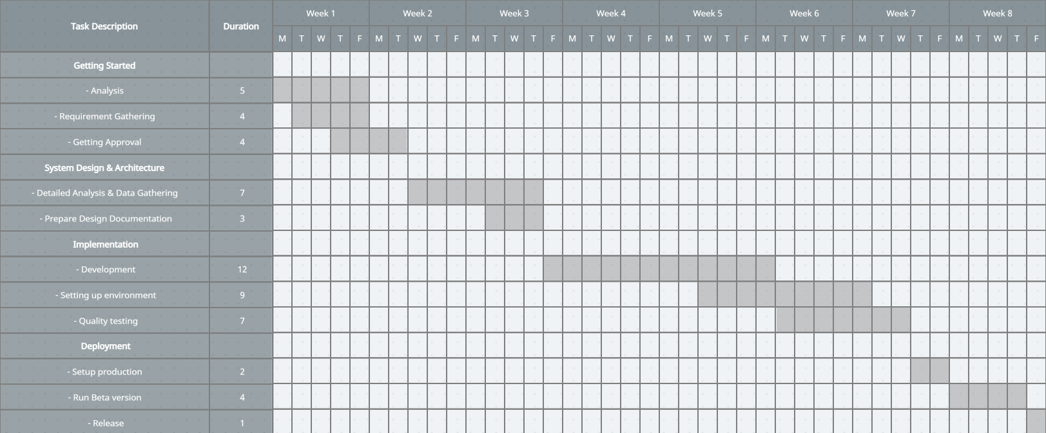
Gantt Chart

Slide 18
Summary of Test plan
Function | Description | %Test-Cases Executed | %Test-Cases Passed | Test-Case Pending | Priority
New Customer | Created new account | 100% | 100% | 0 | High
Booking | Customer book his/her room | 100% | 100% | 0 | High
Room directory | Customer can see multiple Room List | 100% | 100% | 0 | High
Room Availability | Customer can check which room are available or not | 100% | 100% | 0 | High

Slide 19
GitHub for Source code and All Document :
https://github.com/patelshivam216/SE-Hotel-Management-System

Slide 20
Contribution of team members
201901011_Himanshu Dudhatra | Documentation, UI/UX
201901024_Dhaval Raj | Coding and Implementation, Documentation
201901030_Bhumin Patel | Design, Documentation
201901056_Smit Patel | Design, Documentation
201901057_Shivam Patel | Design, Documentation
201901100_Shubham Patel | Documentation, UI/UX

Slide 21
THANK YOU…

